Slide 1

NASA Vital Signs
Sacred Earth, Sacred Action: Stewardship of Creation

Slide 2
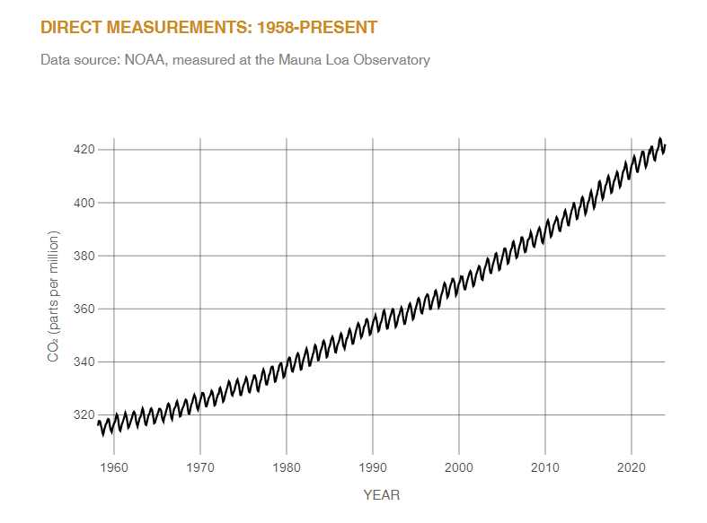
Carbon Dioxide
LATEST MEASUREMENT:
December 2023
422 ppm
Key Takeaway:
Carbon dioxide in the atmosphere warms the planet, causing climate change. Human activities have raised the atmosphere’s carbon dioxide content by 50% in less than 200 years.

Slide 3
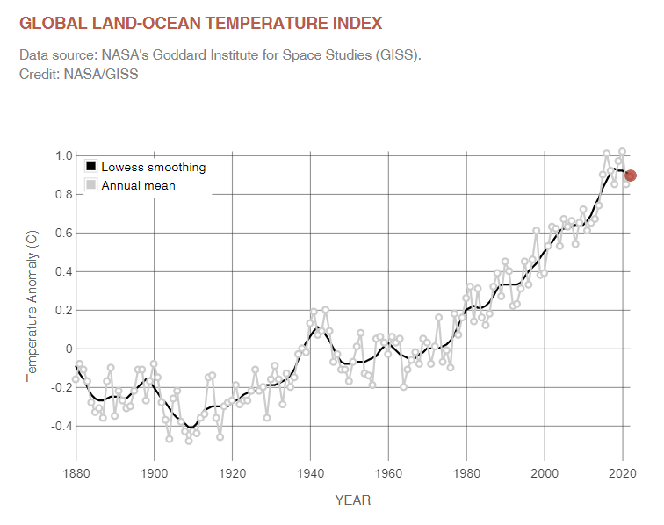
Global Temperature
LATEST ANNUAL AVERAGE ANOMALY:
2022
0.89 °C
1.6 °F
Key Takeaway:
Earth’s global average surface temperature in 2020 statistically tied with 2016 as the hottest year on record, continuing a long-term warming trend due to human activities.
This graph shows the change in global surface temperature compared to the long-term average from 1951 to 1980. The year 2020 statistically tied with 2016 for the hottest year on record since recordkeeping began in 1880 (source: NASA/GISS). NASA’s analyses generally match independent analyses prepared by National Oceanic and Atmospheric Administration (NOAA) and other institutions.

Slide 4
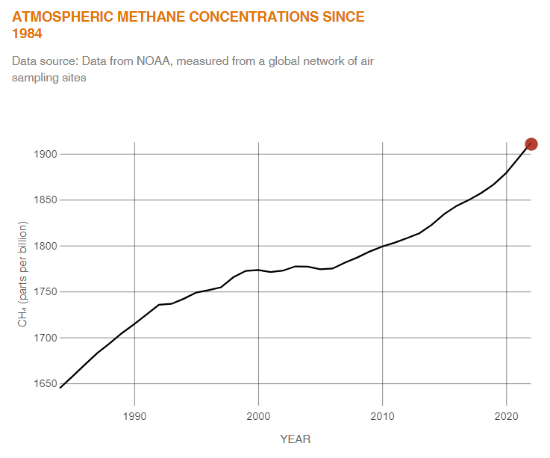
Methane Gas
LATEST MEASUREMENT:
2022
1912 (± 0.6) ppb
Key Takeaway:
Methane is a powerful heat-trapping gas. An estimated 60% of today’s methane emissions are the result of human activities.
Methane Basics
Methane (CH₄) is a powerful greenhouse gas, and is the second-largest contributor to climate warming after carbon dioxide (CO₂). A molecule of methane traps more heat than a molecule of CO₂, but methane has a relatively short lifespan of 7 to 12 years in the atmosphere, while CO₂ can persist for hundreds of years or more.
The largest sources of methane are agriculture, fossil fuels, and decomposition of landfill waste. The concentration of methane in the atmosphere has more than doubled over the past 200 years. Scientists estimate that this increase is responsible for 20 to 30% of climate warming since the Industrial Revolution (which began in 1750).

Slide 5
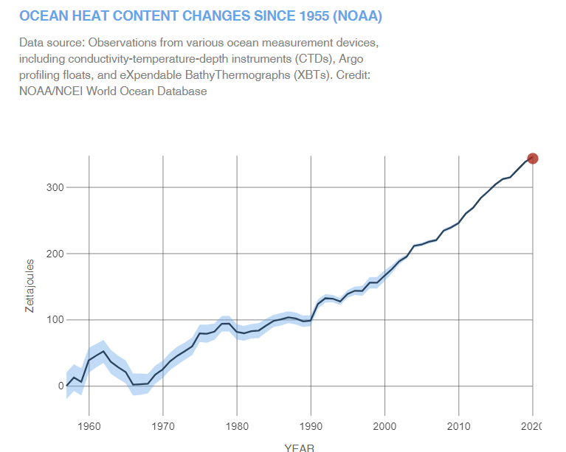
Ocean Warming
LATEST MEASUREMENT:
December 2022
345 (± 2) zettajoules since 1955
Key Takeaway:
About ninety percent of global warming is occurring in the ocean, causing the water’s internal heat to increase since modern recordkeeping began in 1955. (The shaded blue region indicates the 95% margin of uncertainty.) This chart shows annual estimates for the first 2,000 meters of ocean depth.

Slide 6

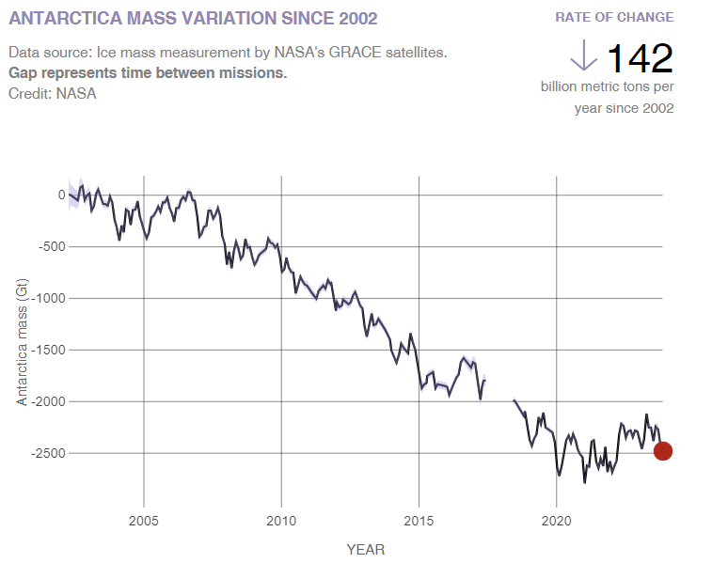
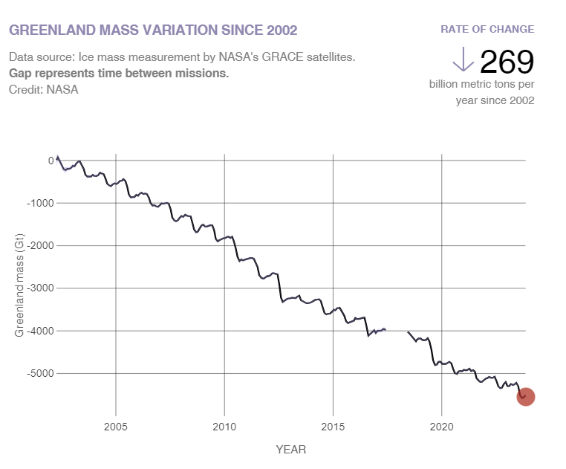
Ice Sheets
Key Takeaway:
Antarctica is losing ice mass (melting) at an average rate of about 150 billion tons per year, and Greenland is losing about 270 billion tons per year, adding to sea level rise.
Data from NASA's GRACE and GRACE Follow-On satellites show that the land ice sheets in both Antarctica and Greenland have been losing mass since 2002.
This is important because the ice sheets of Greenland and Antarctica store about two-thirds of all the fresh water on Earth. They are losing ice due to the ongoing warming of Earth’s surface and ocean. Meltwater coming from these ice sheets is responsible for about one-third of the global average rise in sea level since 1993.

Slide 7
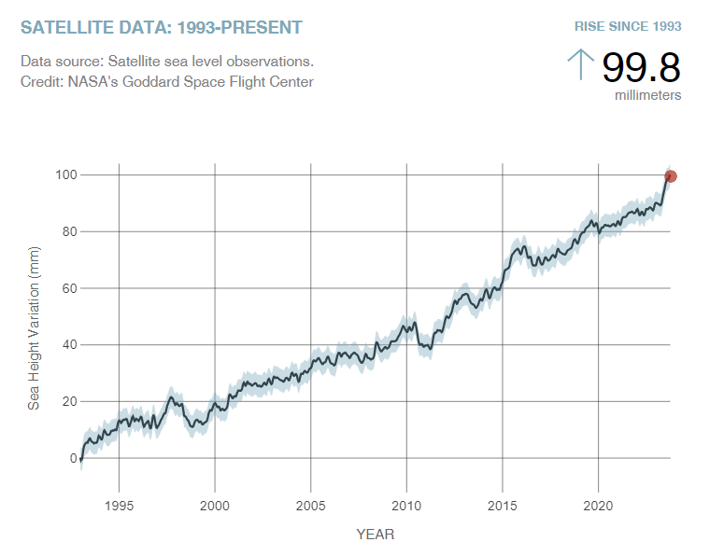
Sea Level
LATEST MEASUREMENT:
October 2023
100 (± 4.0) mm
Key Takeaway:
Global sea levels are rising as a result of human-caused global warming, with recent rates being unprecedented over the past 2,500-plus years.
Sea level rise is caused primarily by two factors related to global warming: the added water from melting ice sheets and glaciers, and the expansion of seawater as it warms. The graph tracks the change in global sea level since 1993, as observed by satellites.

Slide 8
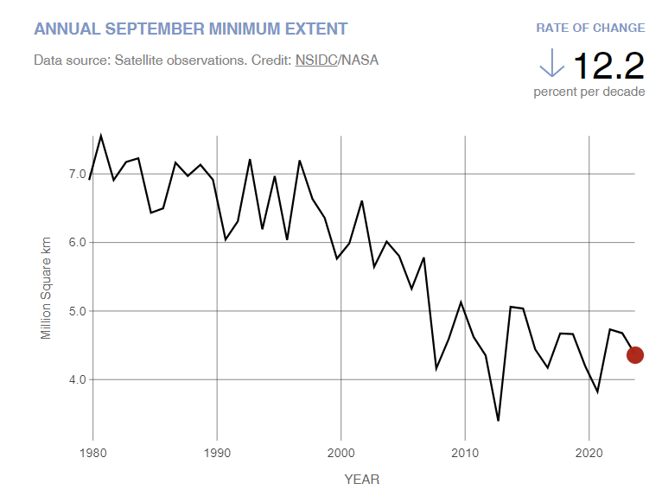
Artic Sea Ice Minimum Extent
Key Takeaway:
Summer Arctic sea ice extent is shrinking by 12.2% per decade due to warmer temperatures.
Arctic sea ice reaches its minimum extent (the area in which satellite sensors show individual pixels to be at least 15% covered in ice) each September. September Arctic sea ice is now shrinking at a rate of 12.2% per decade, compared to its average extent during the period from 1981 to 2010. This graph shows the size of the Arctic sea ice each September since satellite observations started in 1979. The monthly value shown is the average of daily observations across the month of September during each year and is measured from satellites.

Slide 9
Discussion questions
What did you think/feel about Creation Care before today?
What surprised you/was new to you?
What are you going to do about it?

